Slide 1

CUSTOMER RETENTION
Internship Presentation
UNDER SUPERVISION OF :
SHUBHUM YADAV
SUBMITTED BY:
AKANKSHA SRIVASTAVA
(Data Science Intern)

Slide 2

TABLE OF CONTENTS
Introduction
Analytical Problem Framing
Data Pre-Processing
Conclusion

Slide 3
INTRODUCTION
Customer retention means the process of maintaining or keeping customers once you have acquired them.The goal is to build a long-lasting relationship between the brand and consumers. Once a customer becomes loyal to your brand, not only he/she will buy more from you than a normal customer but he’ll spread good words about your business, increase your reputation.
Customer retention is most important for every business, but it's especially significant for ecommerce organizations. After all, with an online business, you lack the opportunity to connect with customers. This inability to build face-to-face relationships can cause customer churn. When we come to know about online shopping we know that now a days it’s a part of human life.
Due to online shopping people can buy anything by sitting at their home. Due to rapid growth of technology, business organizations have switched over from the traditional method of selling goods to electronic method of selling goods. Business organizations use internet as a main vehicle to conduct commercial transactions.

Slide 4
There are few popular online shopping websites mentioned below:
Amazon
Flipkart
Myntra
Snapdeal
Pharmacy
Big Basket
There is a good reason for why people prefer online shopping instead of shopping from outdoor.
Saves time and efforts.
Convenience of Shopping at home.
Wide variety and range of products are available.
Good discounts and lower prices.
Get detailed information of the product.
We can compare various models and brands

Slide 5
ANALYTICAL PROBLEM FRAMING
I have got a project on Customer Retention. It’s all depending upon Online Shopping Websites which are using all over the world. Now, I am going to analyze the detailed review of every online shopping websites which are used for shopping. I have given data in xsl format.
Firstly I have converted it into csv format and saved with the name customer retention.
Next, I have some imported libraries like numpy imported for numerical computing, pandas imported for data manipulation and matplotlib and seaborn imported for Visualizations and warning imported for to avoid the any warnings.
After imported dataset, I found that there are 71 columns and 269 rows in the dataset.
After that I saw that there are too lengthy columns & there is lot of punctuations and space.
So, I have started pre-processing.

Slide 6
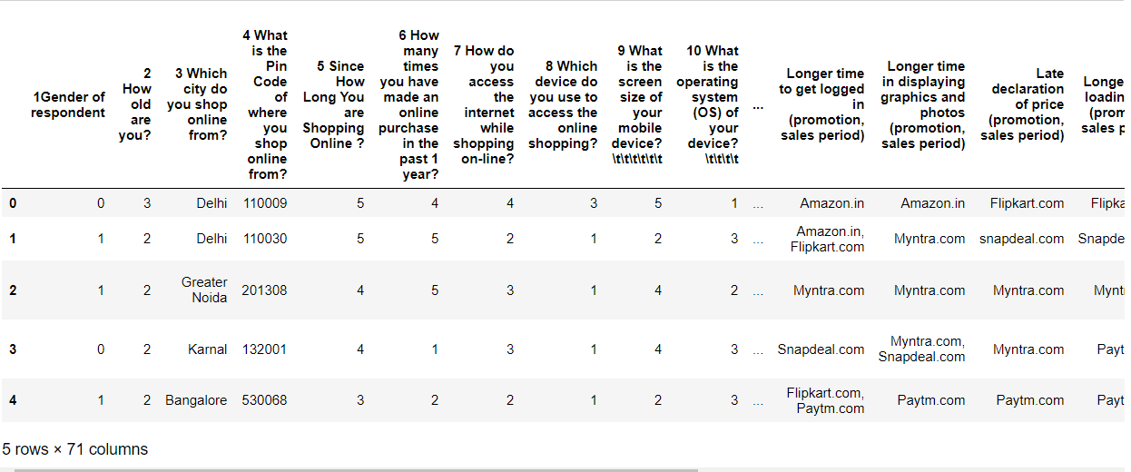
Data Pre-processing
Here we can find that columns are inappropriate way there is lots of punctuations present in the dataset

Slide 7
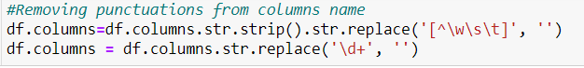
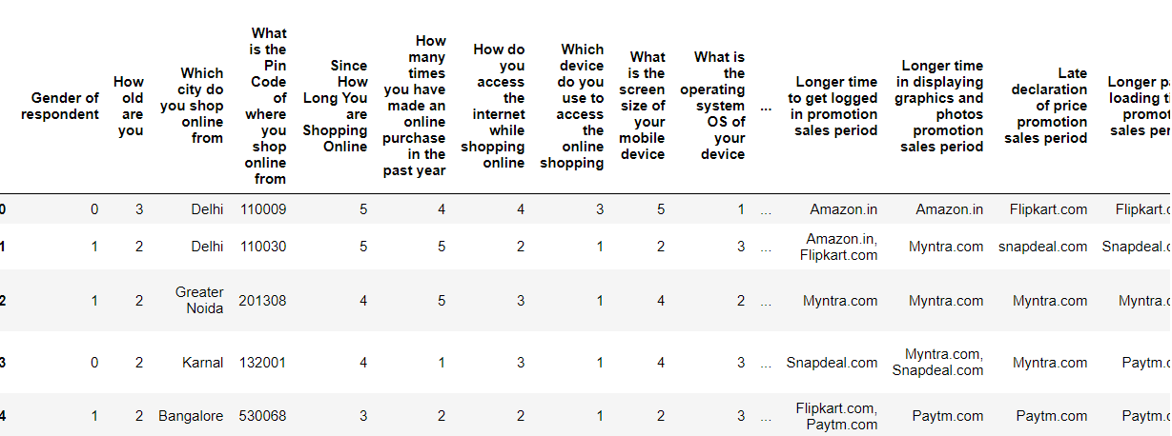
Now we can see that all the punctuations are removed from the column name

Slide 8
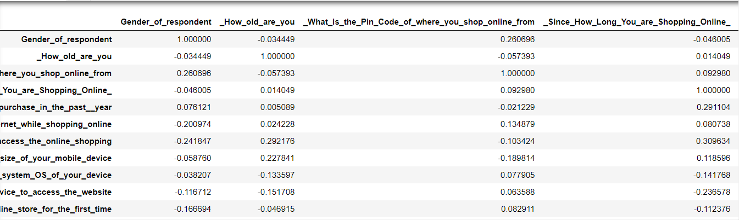
Checking correlation
Now here we have check the correlation and now we can identify the which all the columns are negatively correlated with each other and for better understanding we have plotted the graph as well.
Lets plot the correlation

Slide 9


Slide 10
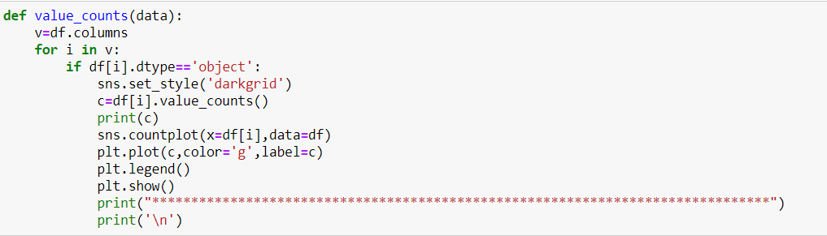
Univariate Analysis
In this data consists of only one variable. Here I have analyzed all the categorical and numerical dataset. In this one function to explore all columns
This is the functions which I have created to plot the categorical columns

Slide 11
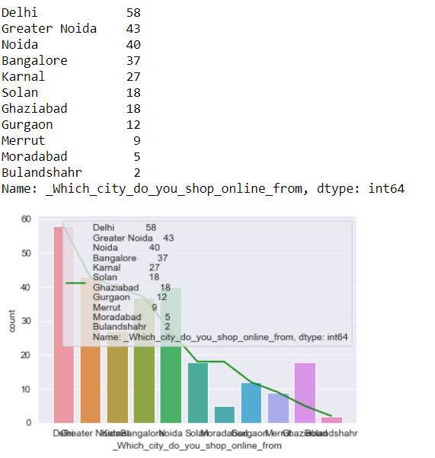
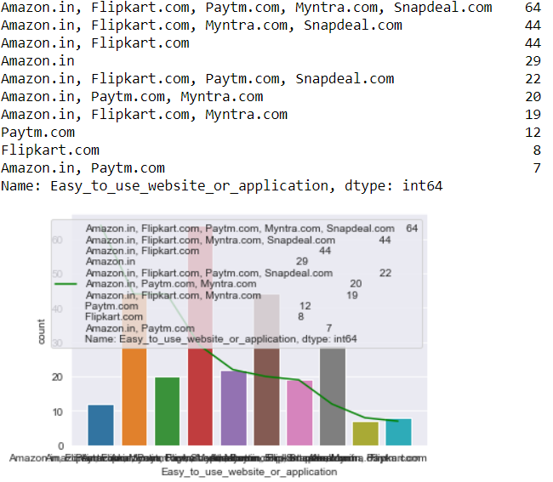

Slide 12
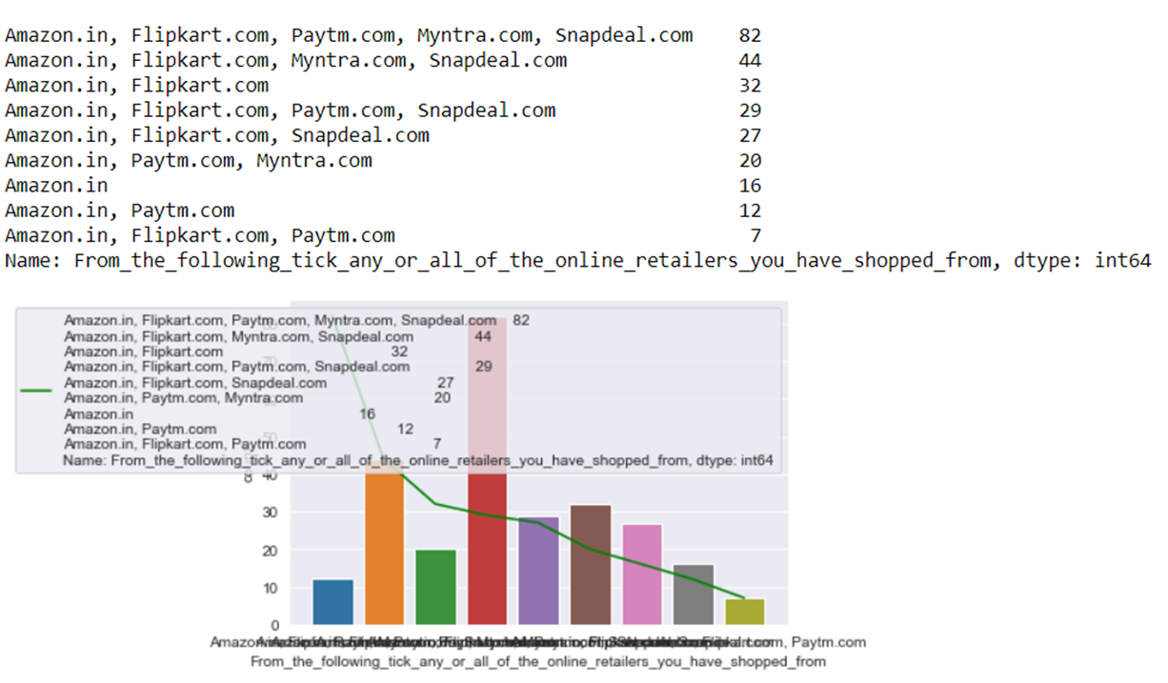

Slide 13
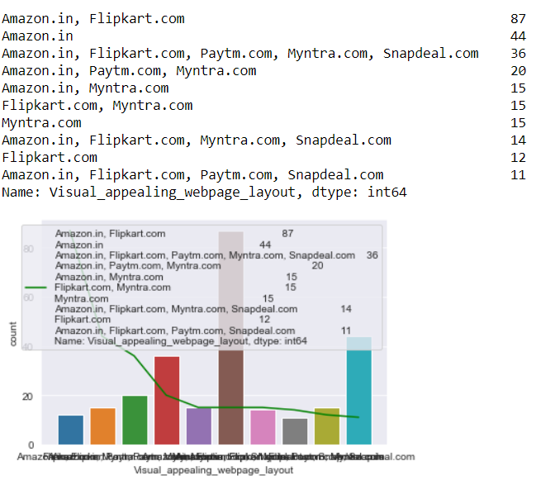
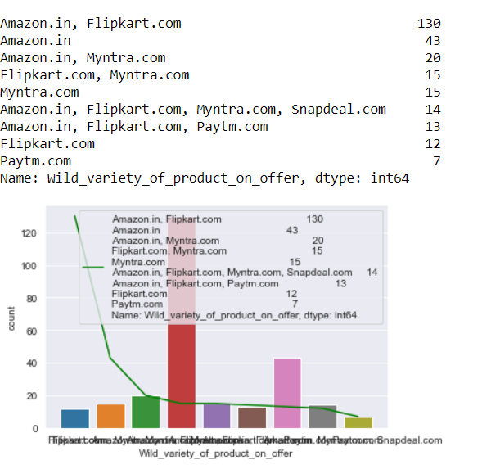

Slide 14
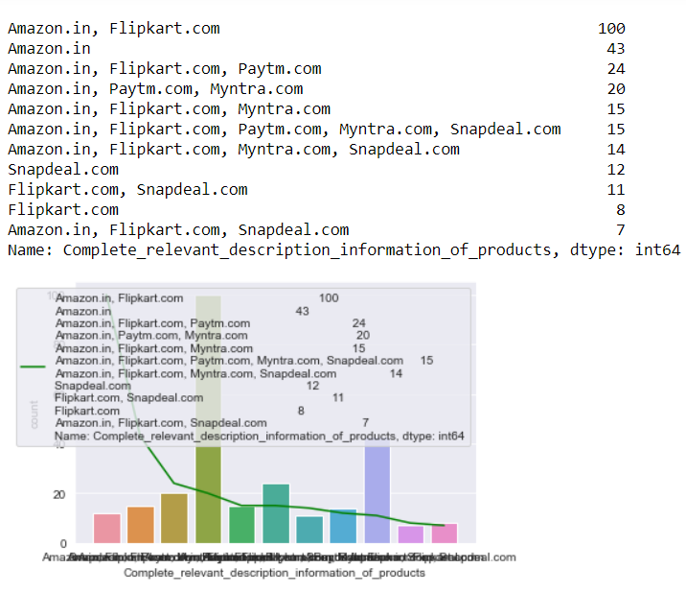

Slide 15
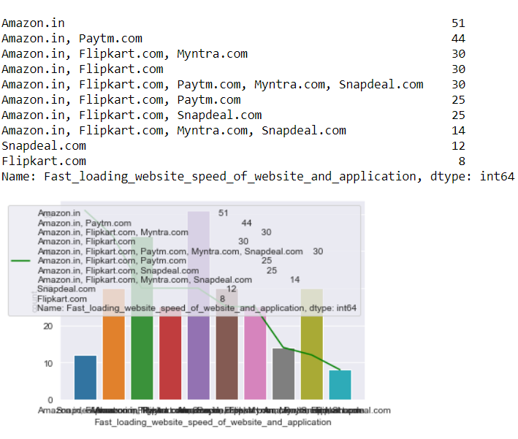
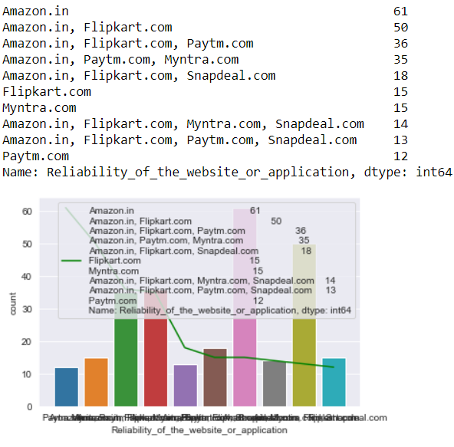

Slide 16
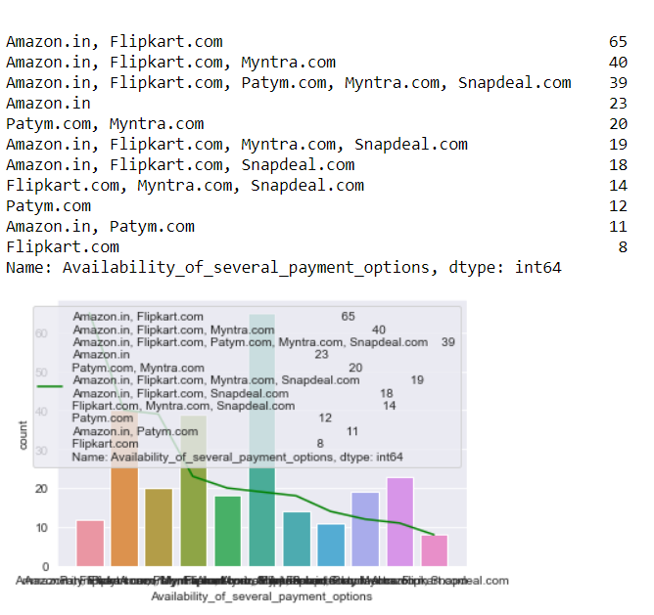
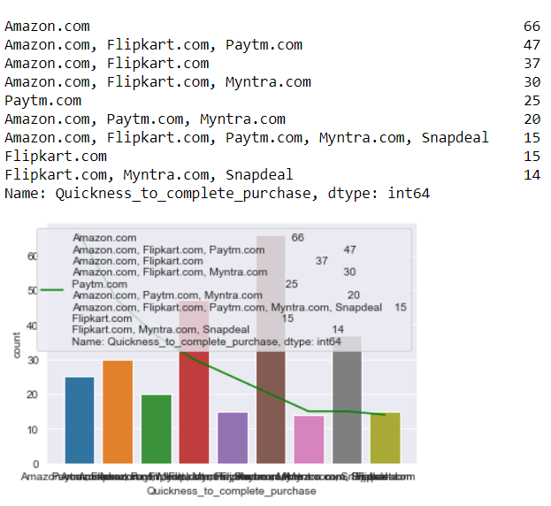

Slide 17
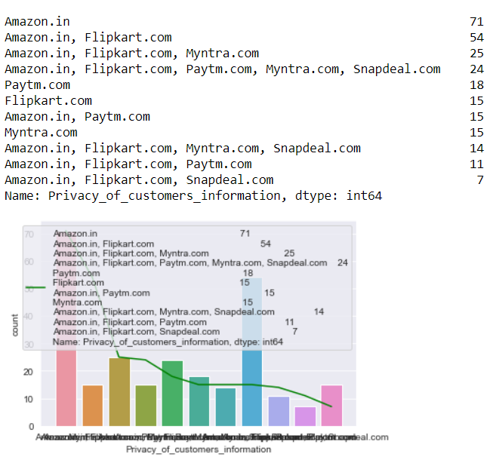
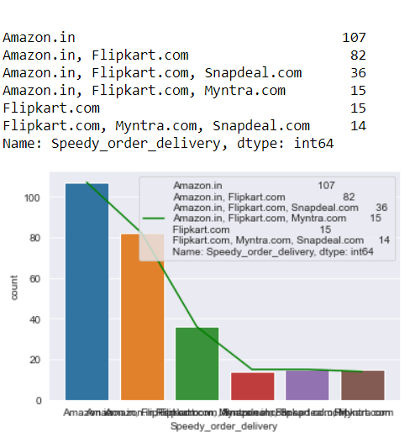

Slide 18
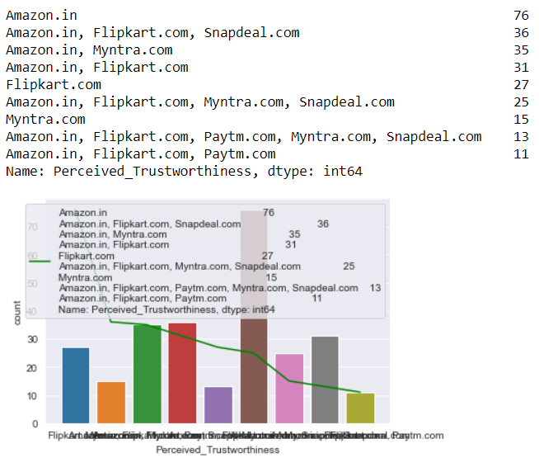
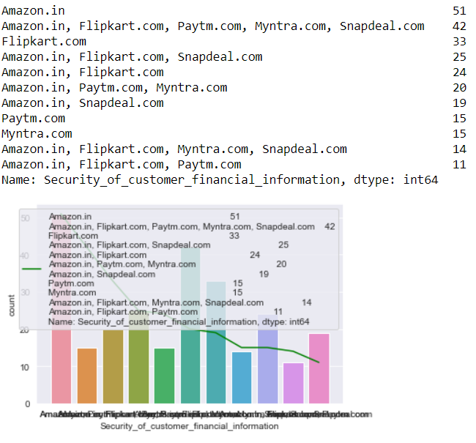

Slide 19
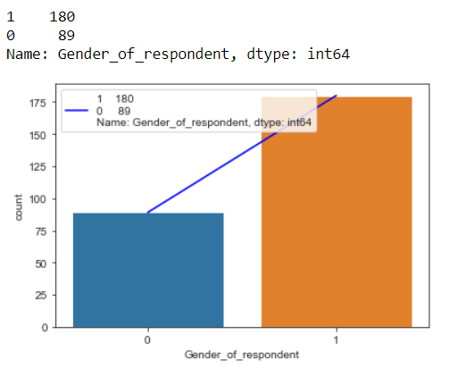
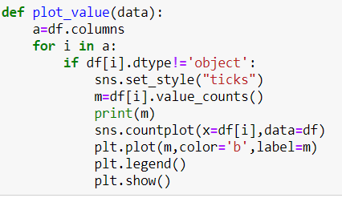
Now we will plot the numerical columns

Slide 20
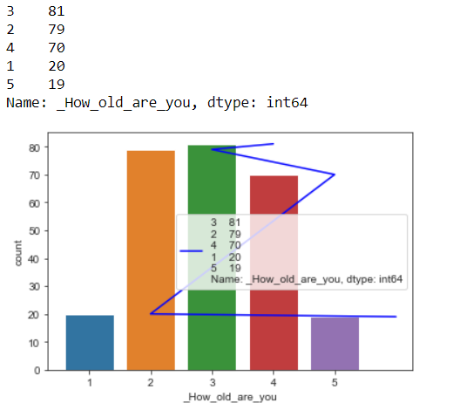
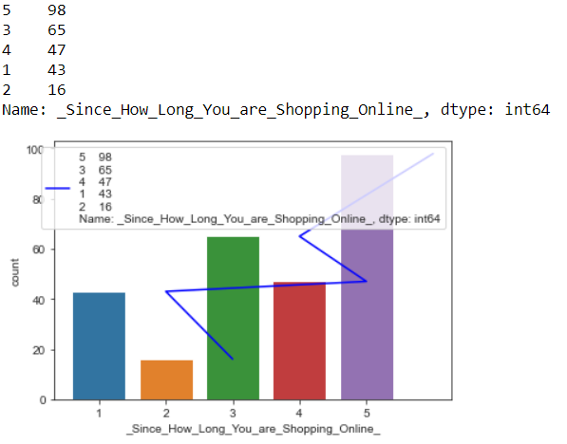

Slide 21
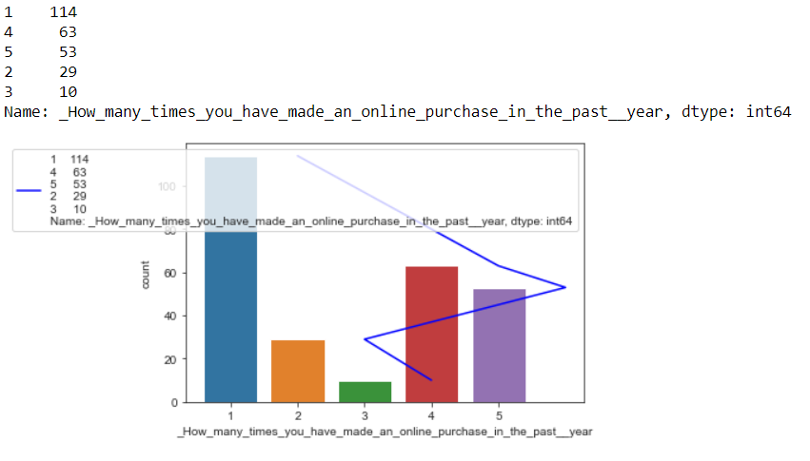

Slide 22
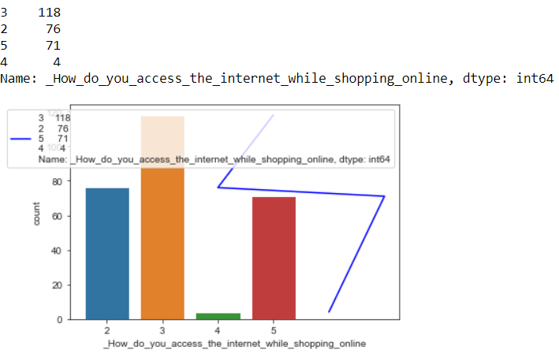
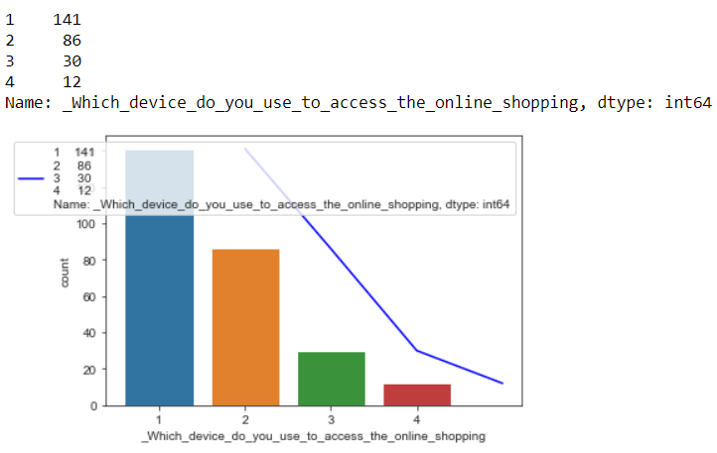

Slide 23
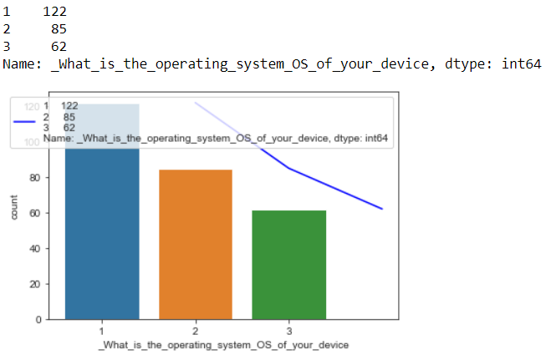
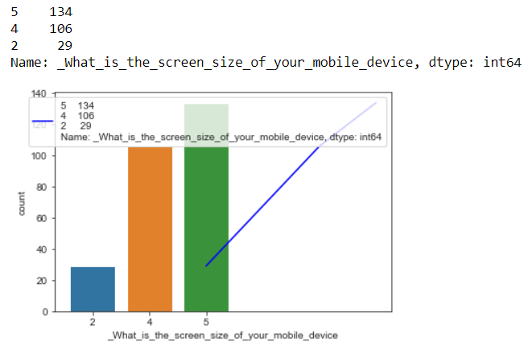

Slide 24
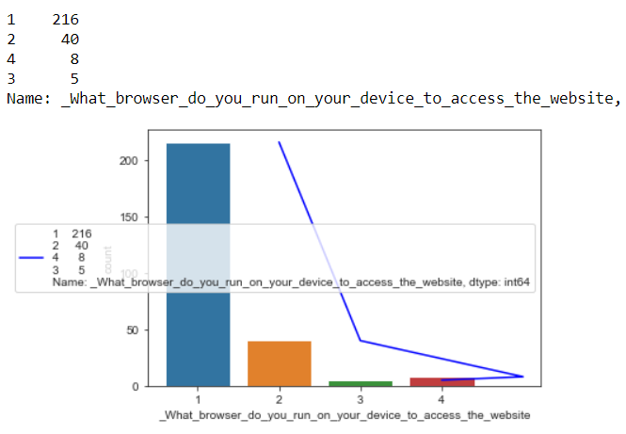
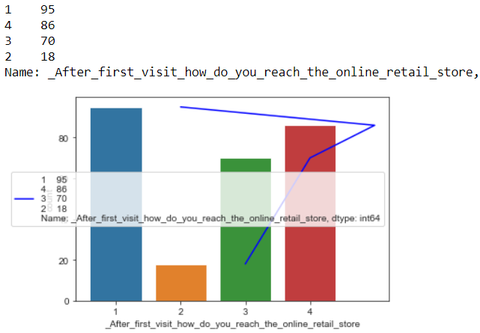

Slide 25
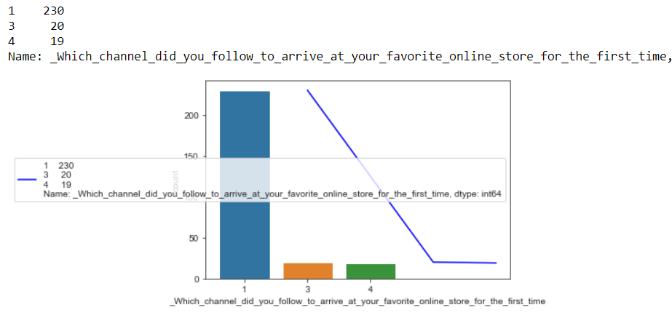

Slide 26
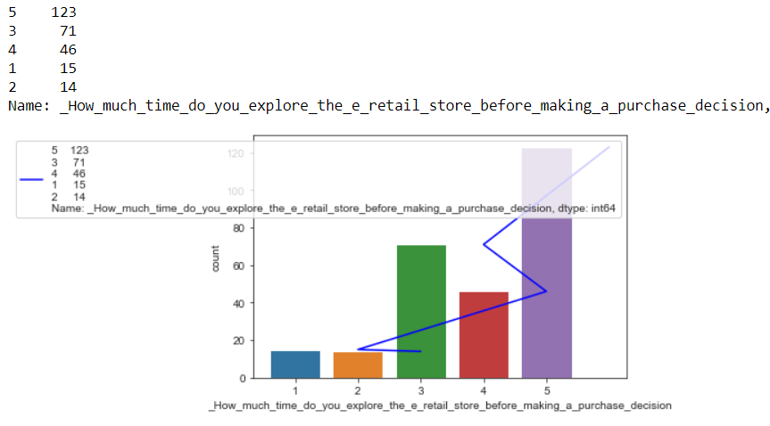

Slide 27
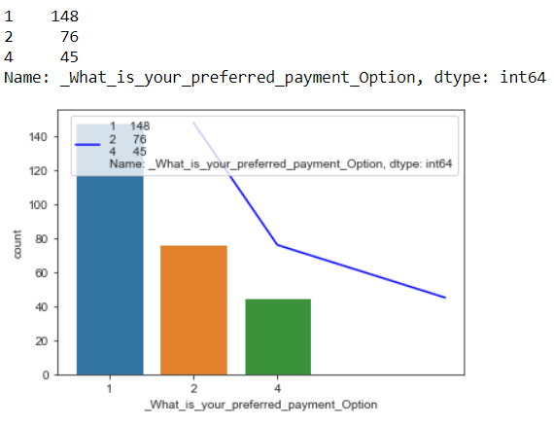
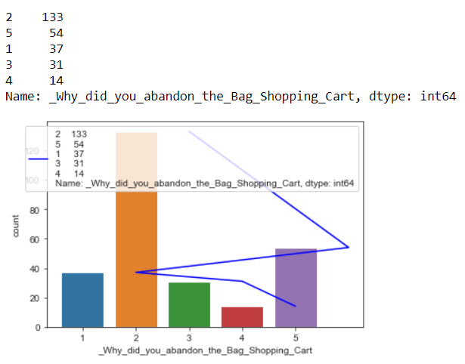

Slide 28
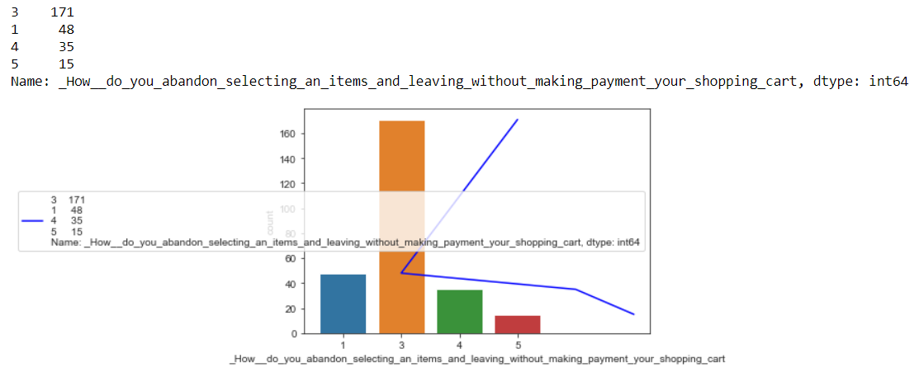

Slide 29
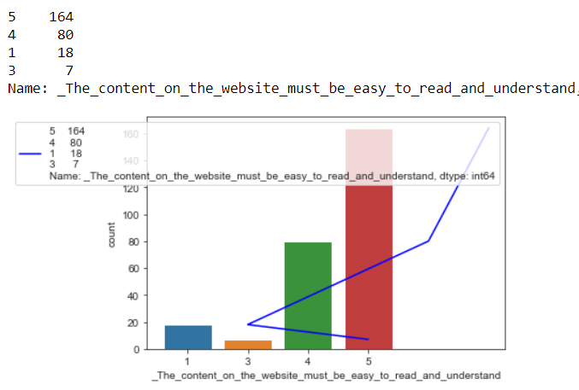
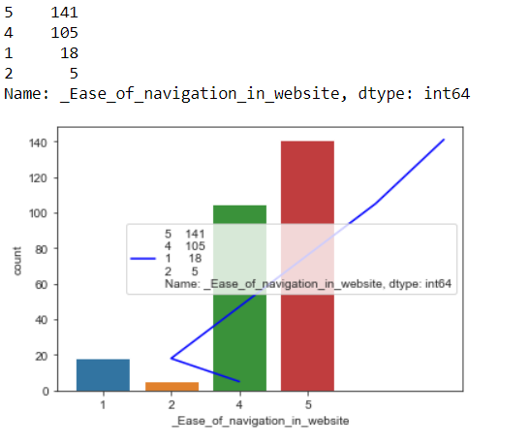

Slide 30
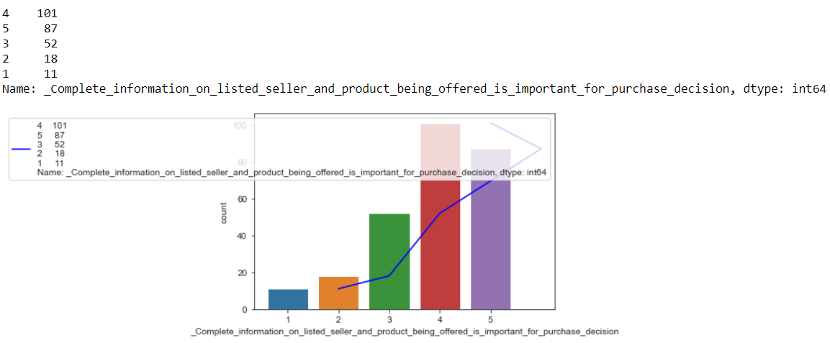

Slide 31
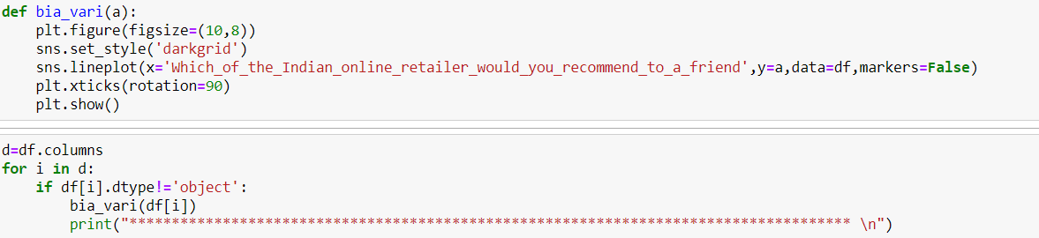
Bivariate Analysis
Coding's I have used to plot the bivariate analysis

Slide 32
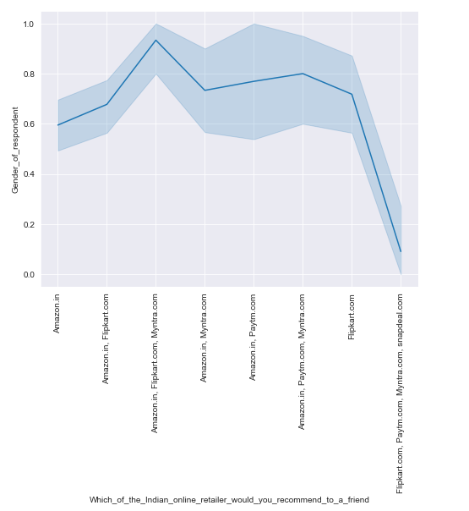
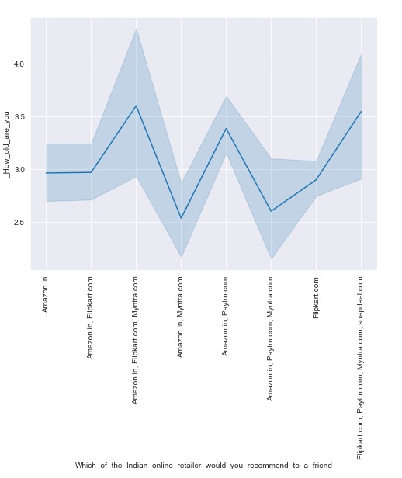

Slide 33
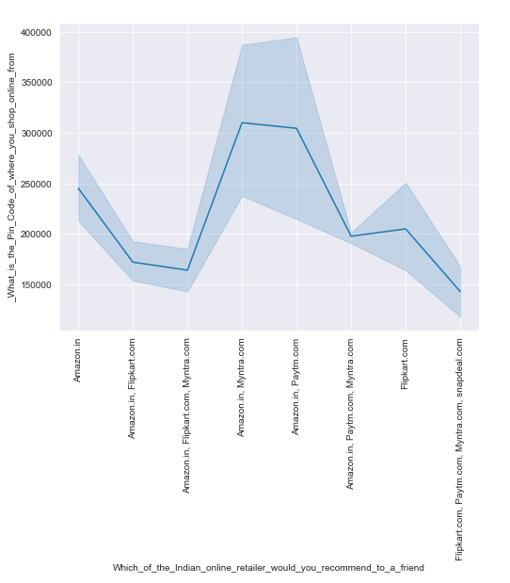
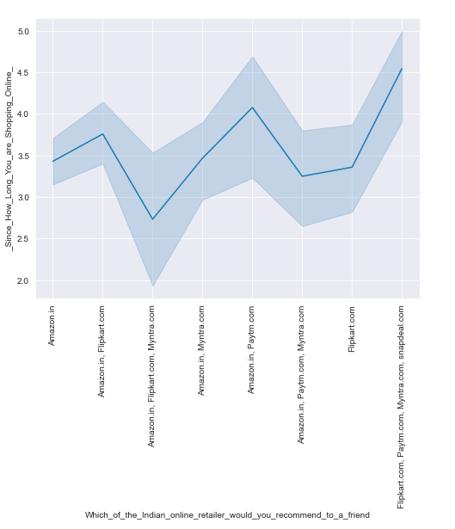

Slide 34
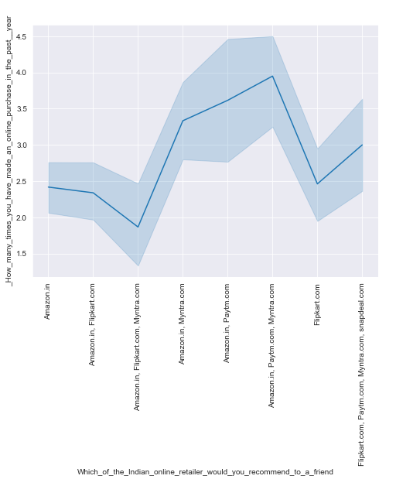
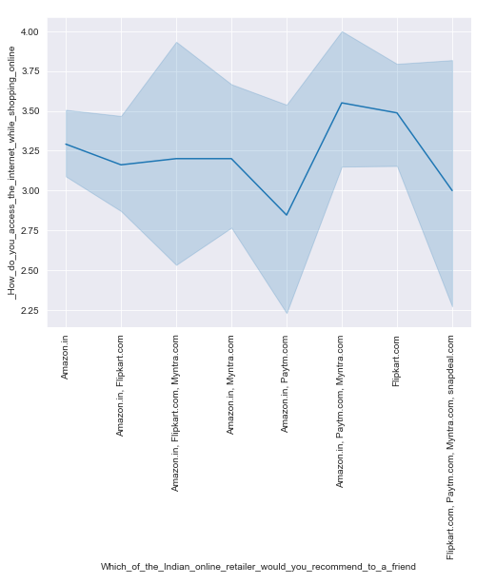

Slide 35
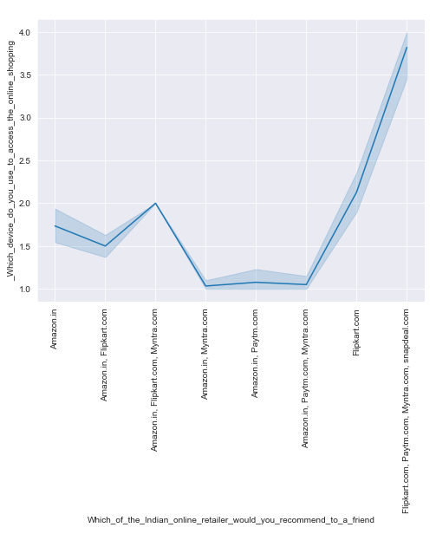
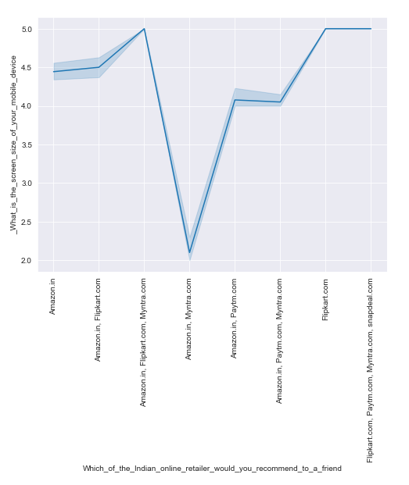

Slide 36
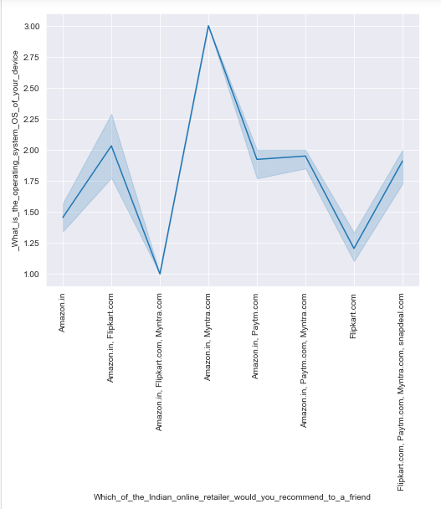
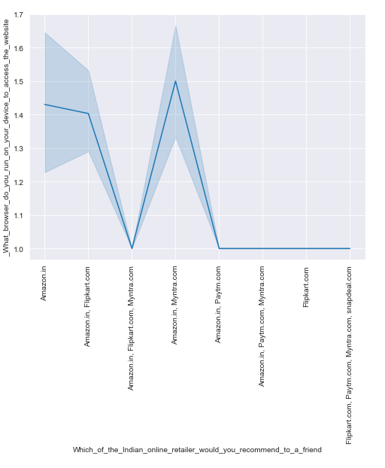

Slide 37
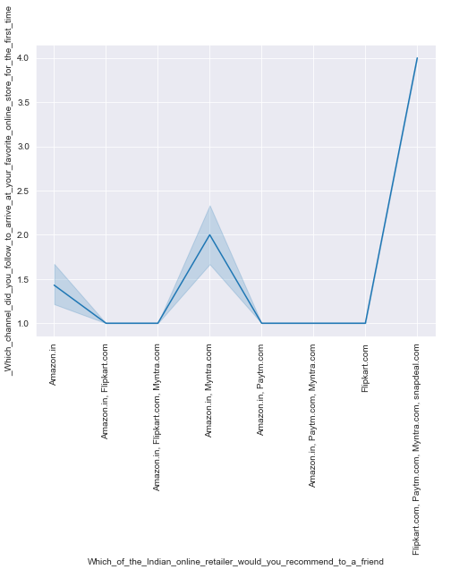


Slide 38



Slide 39




Slide 40



Slide 41



Slide 42



Slide 43



Slide 44



Slide 45



Slide 46

Exploring Categorical Columns

Slide 47


Slide 48


Slide 49


Slide 50


Slide 51


Slide 52

Multivariate Analysis
(x='_Which_city_do_you_shop_online_from’
y='_Getting_value_for_money_spent’
hue='Gender_of_respondent'

Slide 53

x='Easy_to_use_website_or_application’
y='_Shopping_on_the_website_helps_you_fulfill_certain_roles’
hue='Gender_of_respondent'

Slide 54



Checking Skewness

Slide 55




Slide 56




Slide 57




Slide 58




Slide 59
Converted into Numerical columns
I have around 25 columns are categorical column
than convert into numerical column.
Checking Outliers
Now I have checked the outliers of few columns
using box plot and I found that outliers are
present in the dataset.
Treating Outliers
Here I have treated the outliers using IQR method

Slide 60
CONCLUSION
E-Commerce is not just about conducting business transactions via the Internet. Its impact will be far-reaching, and more prominent then we know currently. This is because the revolution in information technology is happening simultaneously with other developments, especially the globalization of the business. The new age of global e-commerce is creating entirely new economy and that will tremendously change our lives, will reshape the competition in various industries, and alter the economy globally. As companies are gaining high profits, more and
more other companies are developing their websites to increase their profits. Since more businesses are being held online resulting in high economy development and emergence of a more innovative and advanced technology.
From the inception of the Internet and e-commerce, the possibilities have become endless for both businesses and consumers. Creating more opportunities for profit and advancements for businesses, while creating more options for consumers. However, just like anything else, e-commerce has its disadvantages including consumer uncertainties, but nothing that can not be resolved or avoided by good decision-making and business practices.
In our project we have seen the which website is growing day by day people mostly prefer which website.

Slide 61



